Slide 1
# of records
# of species
# of redlist
Pteropods (see slide)
Deepest fish
(see slide)
Future
Environmental data
Tracking data
DNA
eDNA
Image/video data
Quality annotations
Text mining for new records
Citizen science
# of records
# of species

Slide 2
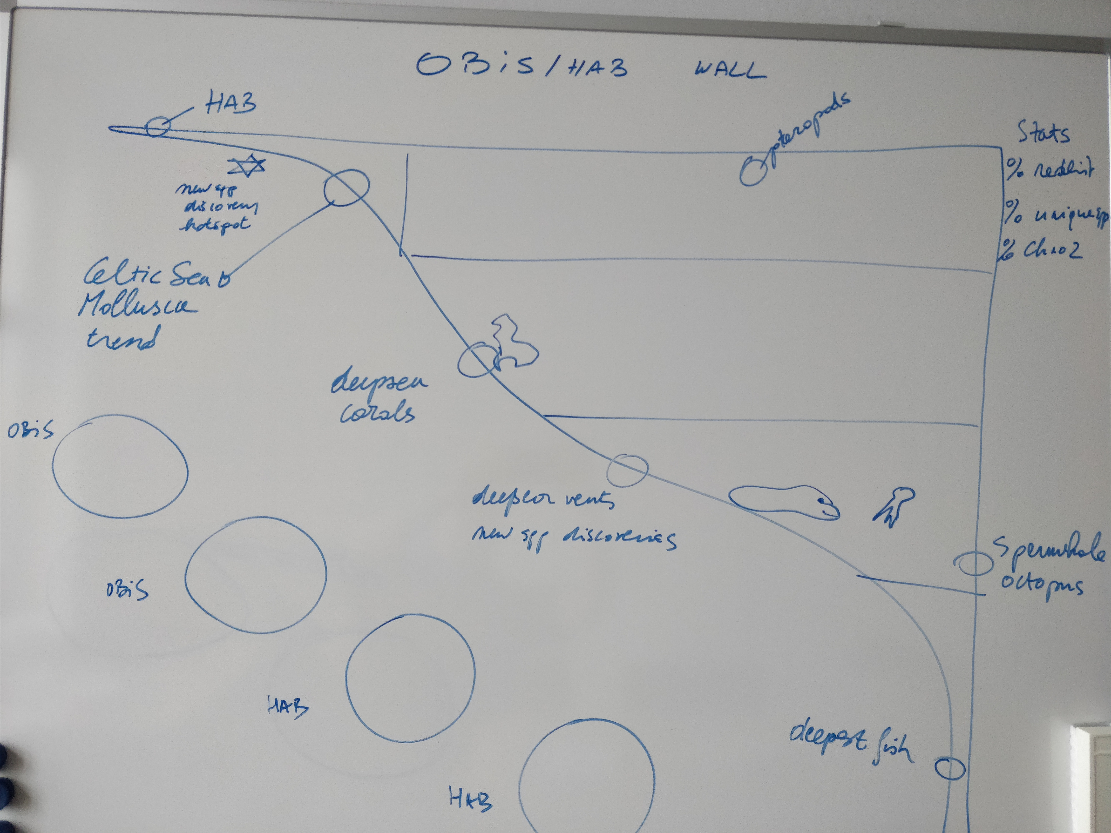

Slide 3
Nice quotes / Text ideas
The most commonly reported sources of species occurrence data were the Ocean Biogeographic Information System (OBIS) and Fish Base.
Freer, Jennifer J., et al. "Predicting ecological responses in a changing ocean: the effects of future climate uncertainty." Marine biology 165.1 (2018): 7.

Slide 4
Pteropods
Pteropods – or sea butterflies – are tiny sea snails which play a critical role in various ocean ecosystems. Because of this critical role there is great concern about the potential impact of global change and particularly ocean acidification on these organisms. Changes in pteropod abundance could have strong impacts, as they play a critical role as a food source for fish, birds, whales and other zooplanktonic organisms.
Modeling. In order to model the impact of ocean acidification and global warming on pteropods, risk indicators have been calculated for major pteropod species.
Results. Under the pessimistic CO₂ emissions scenario, it is likely that by 2050 the chemical conditions of the water in most of the Arctic Ocean will limit the formation of pteropod shells, meaning they will not be able to thrive in most of the Arctic Ocean. The temperate water species will also very likely be affected by global change, with only 26% of the ocean representing low risk for them by 2050. Warm water species probably will not be as strongly affected by ocean acidification by 2050, but excessive temperatures will likely reduce their area of distribution, particularly in the equatorial Pacific.
http://onesharedocean.org/open_ocean/ecosystems/pteropods_at_risk
Photo credit: Russ Hopcroft, UAF/NOAA
CC BY-NC

Slide 5
Abyssobrotula galatheae Nielsen, 1977
Abyssobrotula galatheae, is a species of cusk eel in the family Ophidiidae. It is one of the deepest living fish in the world. Though uncommon, this species is known from all tropical and subtropical oceans. It occurs below a depth of 3,110 m (10,200 ft) and is bottom-dwelling in nature. Its diet consists of polychaete worms and crustaceans, such as isopods and amphipods.
Source: Smithsonian Institution, National Museum of Natural History,
Department of Vertebrate Zoology, Division of Fishes
CC BY-NC-SA

